Slide 1


Sussex Mental Health Research Engagement Network
REN Co-Leads: Dr Anna-Marie Bibby-Jones & Virginia Govoni & NHS Sussex
Expression of Interest and Information Meeting
11th December 2024
Notes:
NHS Sussex = Russel Shingles, was Jane Lodge Deputy Director of working with People and Communities

Slide 2
Background: Nationally
2nd year of National Research Engagement Network to address barriers to inclusion in research
Funded by NHS England, Department of Health & Social Care , National Institute for Health & Care Research (NIHR)
Approx £10m+ across 42 regions (Integrated Care Boards - ICB)
3 regions got a share of £200k for a Mental Health REN (NIHR Mental Health Fund)
Boost women and people who use women’s health services engagement in mental health research (decided through a collaborative session to set the focus)
Core Aims: To increase diversity, inclusion, and trust in health & care research through partnership working with local communities
Notes:
Research Engagement Network (REN) Development Programme is a national initiative for partnership working to address the systemic barriers to inclusion in research at a national level
Launched 2022
Funded by NHS England, Department of Health & Social Care, with matched funding and resources from Clinical Research Network
Over £8m invested in the national programme
Fund partnership work with Integrated Care Boards (ICBs), local health and care research system and Voluntary, Community & Social Enterprise (VCSEs) to engage underserved communities
All 42 ICBs now have a REN
Key aims to increase diversity, inclusion and participation in health and care research, and building long-lasting trusting relationships with communities.
Strong alignment with policies Long Term Plan, Core20+5 etc.
Strong emphasis on learning and sharing and planning for sustainability

Slide 3
Local settings and background
To improve engagement in health and care research including mental health research, we want to use community-developed engagement methods and community researcher approaches
Invest in capacity building
Also bring health and care researchers and community researchers closer together
Explore how we get to a point of community-lead health and care research or fully embed community research within health and care research
Notes:
Latest news about the Research Engagement Networks here → https://www.bsms.ac.uk/research/support-and-governance/hrp/hrp-news-and-events.aspx#November2024

Slide 4

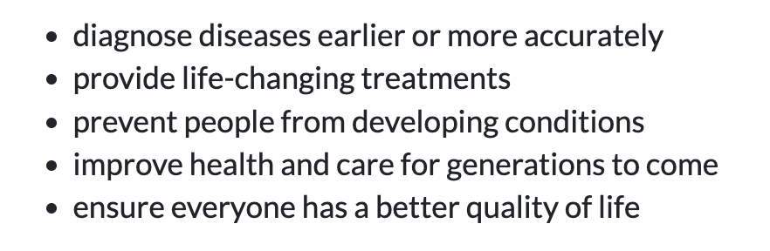



Health and Care research seeks to find answers to the questions about the best options available
Research can…
lead to a new discovery
confirm what we already know
tell us what works under what circumstances and for who
https://bepartofresearch.nihr.ac.uk/about/What-is-health-and-care-research/
Notes:
That was a very simplistic example, but this is what health and care research is trying to do
It seeks to find answers to questions about the best options available.
It then uses these discoveries to make decisions about improvements or changes. This is so we can:
diseases - cancer
life changing-treatments – drugs to increase lung function
prevent diabetes
Health and Care Research is a huge part of the NHS and is a growing part of the social care system
See https://bepartofresearch.nihr.ac.uk/about/What-is-health-and-care-research/
f Social Care

Slide 5

Common features of Health and Care research
Funding – National Institute for Health and Care Research (NIHR), Research Councils, Charities
Patient & Public Involvement (PPI) or Public Community Involvement & Engagement (PCIE)
Multidisciplinary teams – clinical trialists, qualitative, clinicians/practitioner academics, economics, stats
Strict ethical and regulatory checks and approvals before it can go ahead
Can take place anywhere in schools, care homes, own home, online, hospital wards, clinics, community, back of an ambulance, the sea,– i.e in. Clinical and Non-Clinical settings
May involve: a survey, taking medication, participating in group talking therapy, 1-1 or self-help, wearing a device which monitors/administers a medicine, changing your diet or exercising
Different Types
Healthcare Research
Social care Research
Public Health Research
Notes:
PPI should fit firmly at the heart of our health and care research
research is done with and for instead of on and to
the Medical Research Council (MRC)
the British Heart Foundation
Cancer Research UK
the Economic and Social Research Council
Healthcare research aka clinical trials examining/observing people with different conditions + comparing to those who don’t have the condition / splitting people up with a condition and testing an intervention
Testing blood or doing scans or xrays.
Analysing patient information from clinical notes or doing survey
Social care research – Research that looks at how the lives of those who are using support from the social care sector can be improved e.g. monitoring exercise of dementia patients or care home residents,
Public health research - Research that affects society as a whole such as the effects of diet and exercise, smoking, participation in vaccination programmes

Slide 6



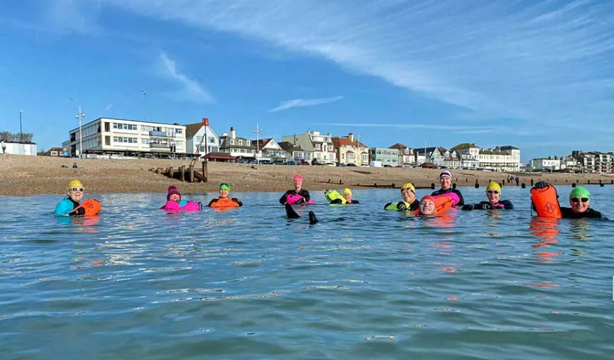
Live examples of local Health & Care Research studies
ECHOES
OUTSIDE
Reduce2
NODEM
https://bepartofresearch.nihr.ac.uk/
Notes:
ECHOES - Design and pilot new school-based support for young people who are hearing voices. Co-design with young people, a plus one, and teachers.
OUTSIDE – Randomised Controlled Trial of around 550 across the country looking at effects of open water swimming (Sea, Lido’s pond) in different area on depression – focus on recruiting people from minoritised groups and also people with disabilities and veterans
NODEM – Understanding the attitudes, views and practices of patients with memory problems but with out a diagnosis of dementia. 50+ yrs of age. Have attended a memory assessment clinic and go back a year later
Reduce 2 - effectiveness of palliative long term abdominal drains for people with untreatable ascites due to advanced cirrhosis COMPARED TO standard short term drains
Improving access to sexual health and wellbeing research and care for women aged 40-65 who live in deprived coastal communities in East Sussex
Given you a flavour of what health and care research is

Slide 7
Mental Health REN Special Call
Why do we need a special mental health call?
Nationally we have a high burden of mental health conditions relative to other health conditions
However, there is limited local mental health research happening
There is also low recruitment into mental health research studies
NIHR want to
develop a collection of at-scale applied health research focussing on the specific mental health-related needs of people in local areas
build research in areas of the country currently underserved by research
Lots of investment in this - £30m

Slide 8
Mental Health REN Special Call
Boosting Community Voices for Involvement and Engagement of Women and people who use Women’s health services in Mental Health Research
Women are 3x more likely than men experience common mh problems
locally we have no large mental health studies focusing on women and people who use women’s health services
COVID-19 significantly worsened mh with a greater decline for women
Barriers to services, support and research exacerbate inequalities leading to poor outcomes for women; there is insufficient data on effect mh interventions for women

Slide 9
Mental Health REN Special Call
Boosting Community Voices for Involvement and Engagement of Women and people who use Women’s health services in Mental Health Research
Sussex Women’s Health Implementation Plan highlights critical intersections
Homelessness – 80% have mh challenge; many relying on A&E; suicidal thoughts, trauma, need better mh support/info
Neurodivergence – 80% have mh challenges; over-reliance on medication and scarce access to therapies
English not first language – issues with translation and interpreting services
Trans, Non-Binary & Intersex – higher mh risks due to minority stress, discrimination and isolation. Neurodivergence is common. 81% experienced depression; exclusion in women’s health services
Isolated older women 50+ - High levels of mh needs, increased suicide risk and reduced life expectancy in coastal areas.

